Slide 1


SCHOOL OF ECONOMICS, DAVV
Presentation on
PROMOTIONAL MIX Of
Submitted to:
Dr. Vasim Khan
SOE, DAVV
Submitted by:
R Balasubramanian Iyer
Shubham Singh Mandloi
MBA Business Economics

Slide 2
OVERVIEW
In this presentation we showcase the various ways the movie “Kabali” utilized promotional strategies to create a new concept of brand promotion in movie marketing.

Slide 3

PROMOTIONAL MIX
Advertising
Sales promotion
Direct Marketing
Product Placement

Slide 4
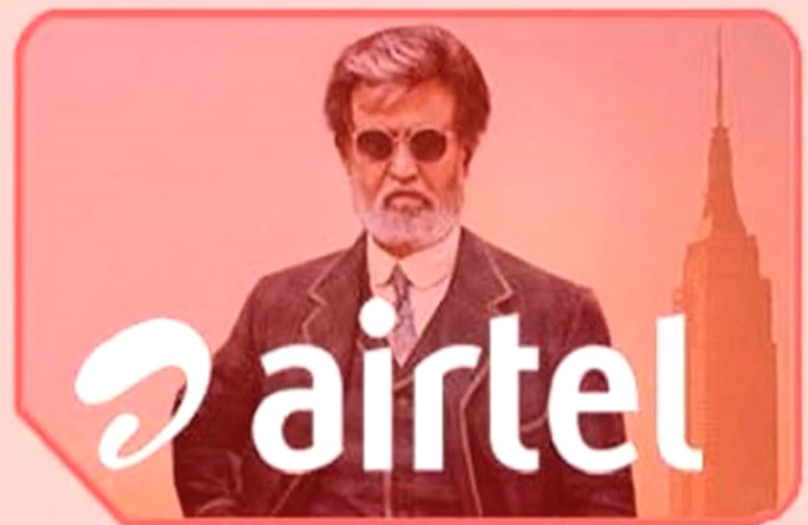
Airtel – Kabali special SIM cards with hello tunes from Rajinikanth movies

Slide 5
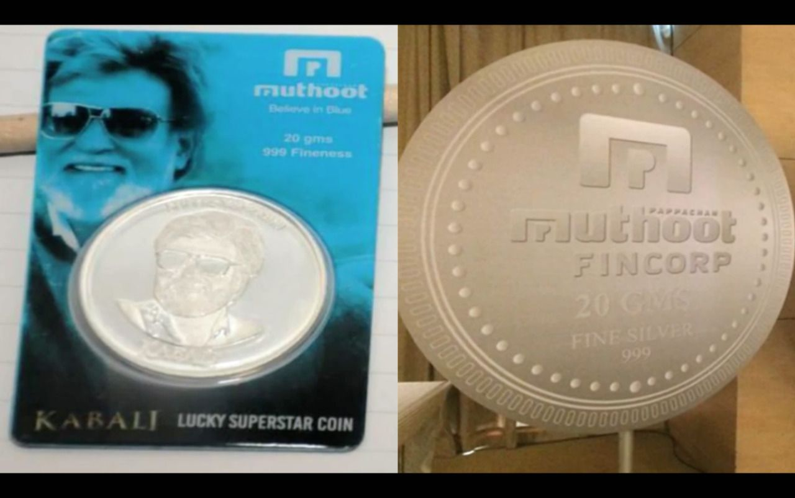
Muthoot Fincorp – Superstar Silver coins with various denominations

Slide 6
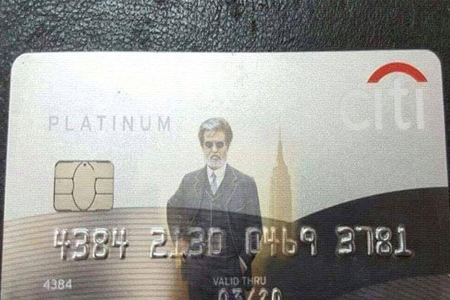
Citibank – Special Kabali Platinum Credit Cards

Slide 7
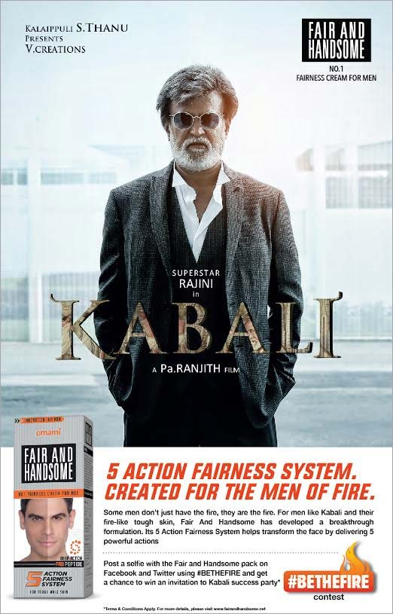
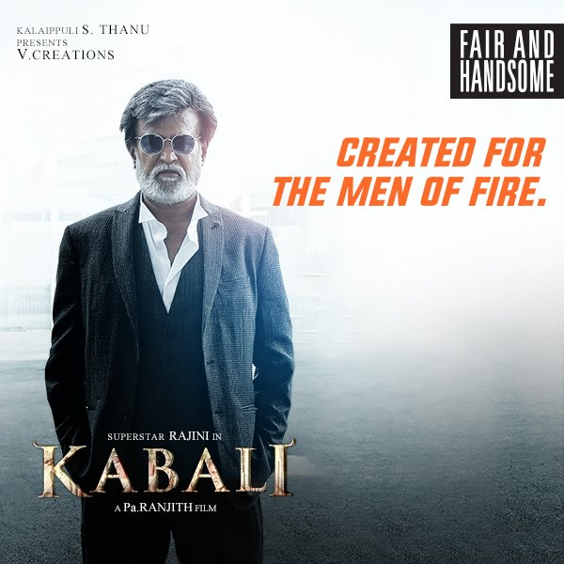
Emami – Fair and Handsome ads

Slide 8
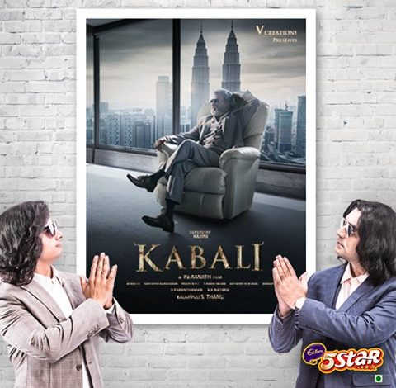
Mondelez – Cadbury 5 Star ads featuring Kabali and popular Ramesh & Suresh

Slide 9
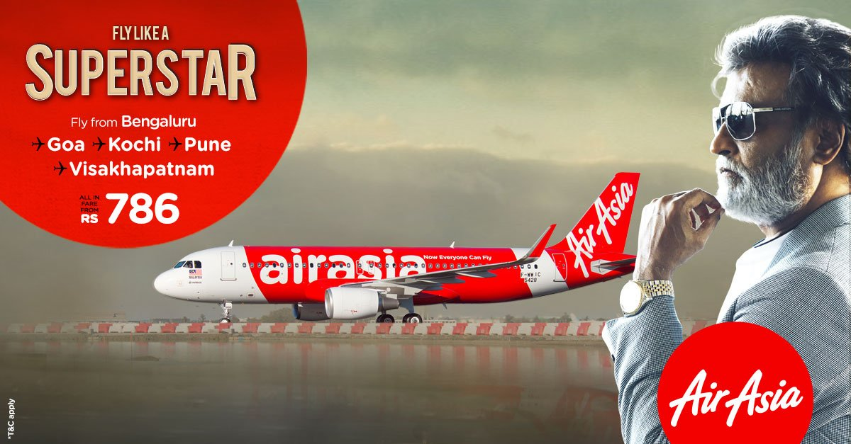
AirAsia – Special Flight offers and sales promotion. AirAsia also made an ad featuring Rajinikanth in a special plane for first day first show bookings

Slide 10
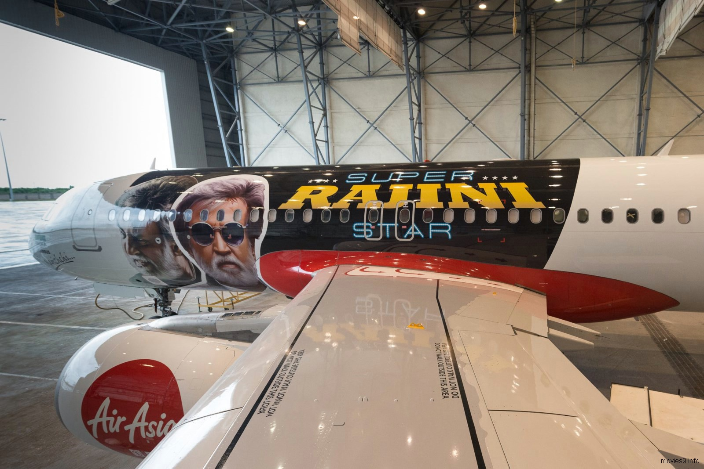

Slide 11
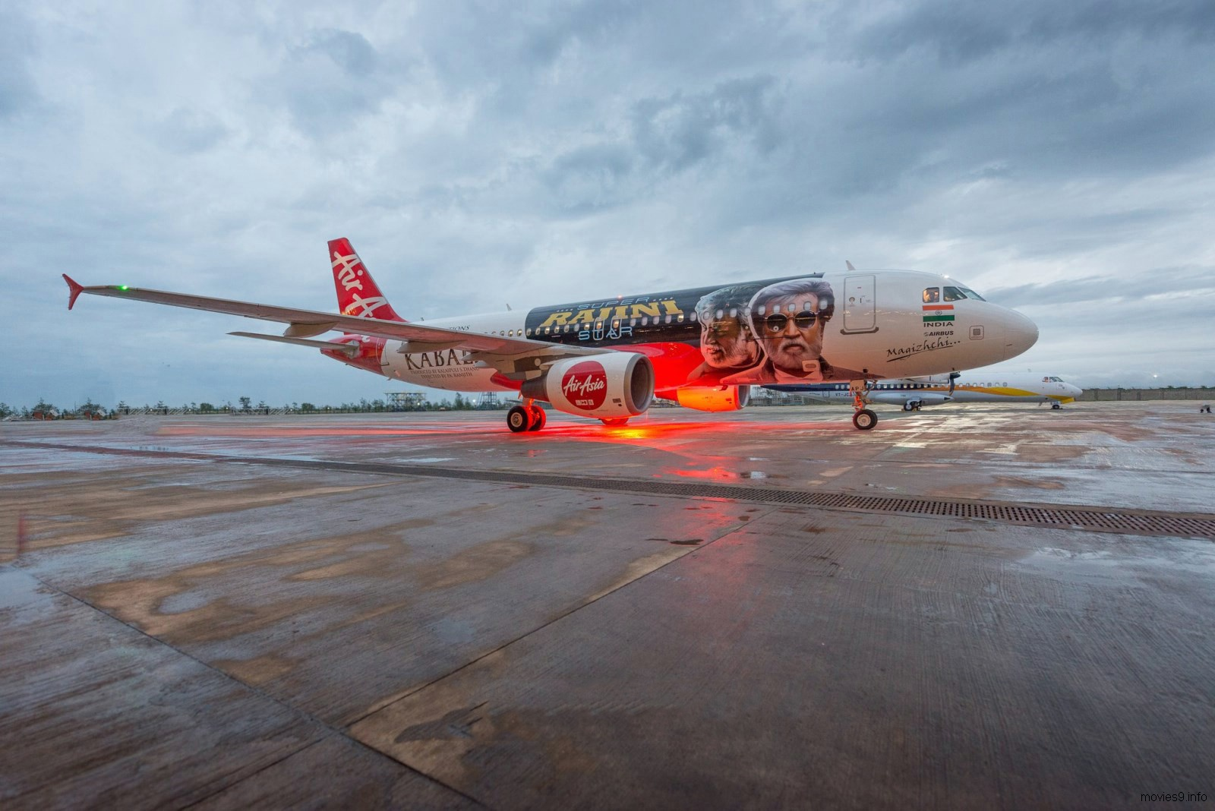

Slide 12



Slide 13
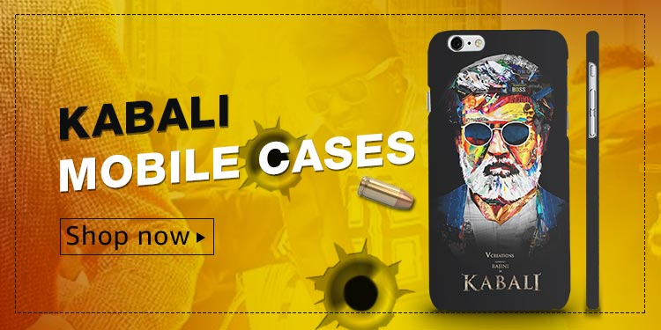

Slide 14
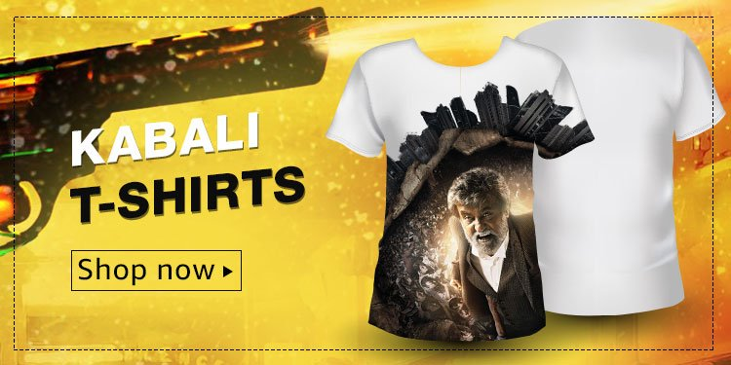

Slide 15
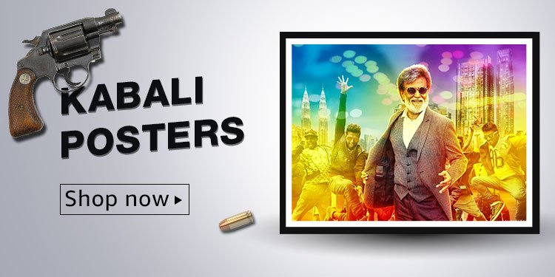

Slide 16
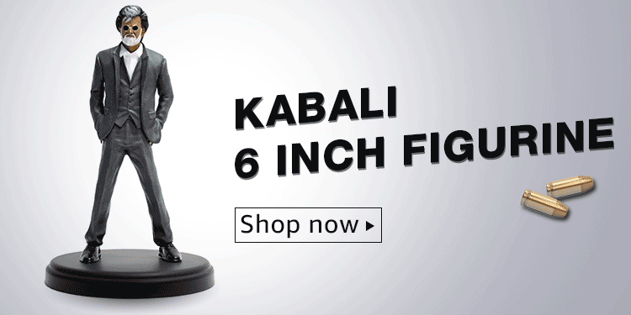

Slide 17
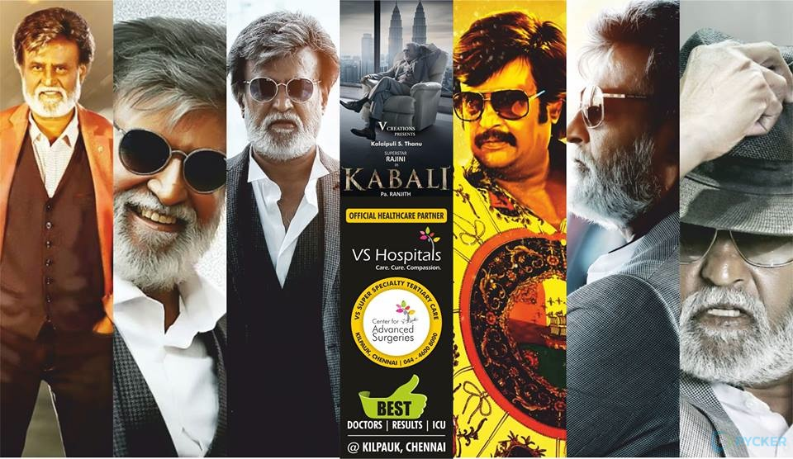
VS Hospitals – Collaboration for healthcare services

Slide 18
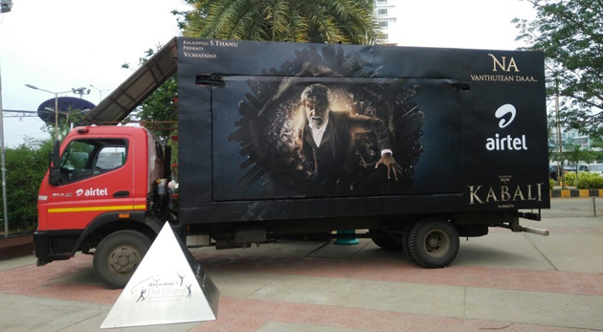
Airtel – Kabali special van showing scenes from previous movies of Rajinikanth and holding contests

Slide 19
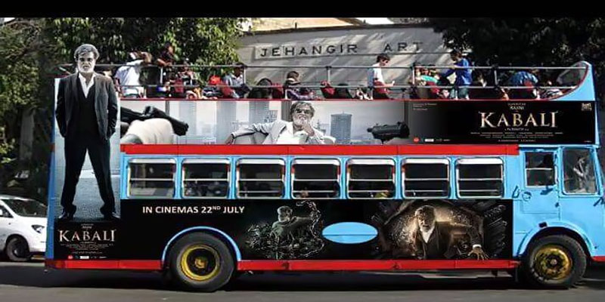
Kabali Bus - Vehicular advertising in Mumbai

Slide 20
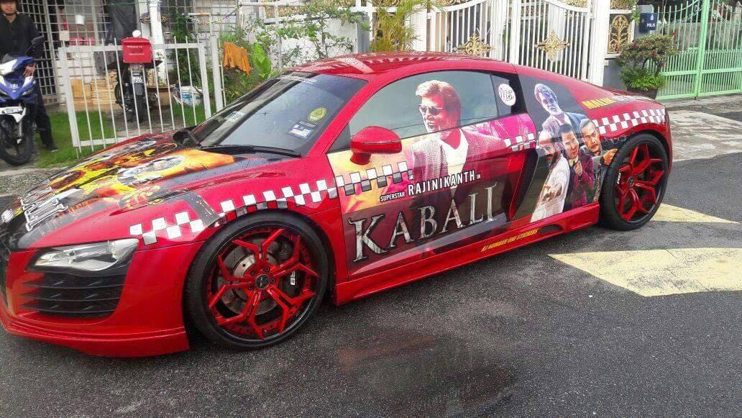
Fans in Malaysia painted entire cars with posters and arts

Slide 21
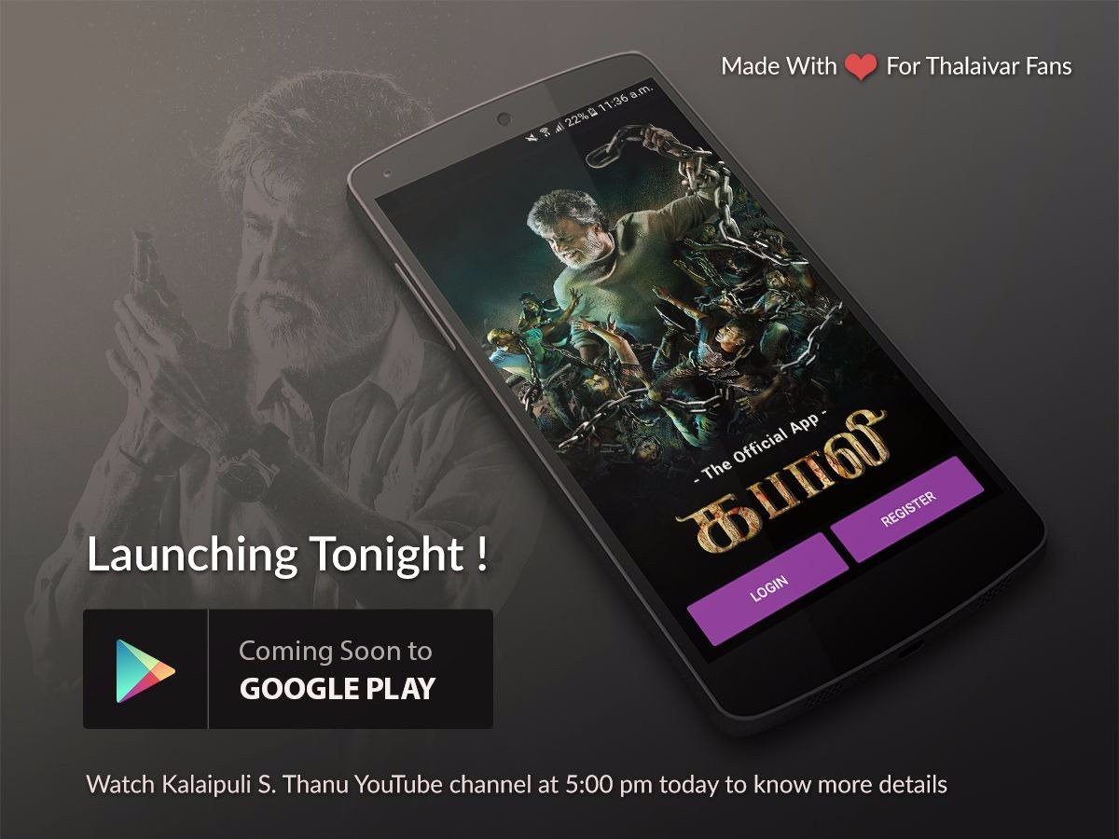

Slide 22
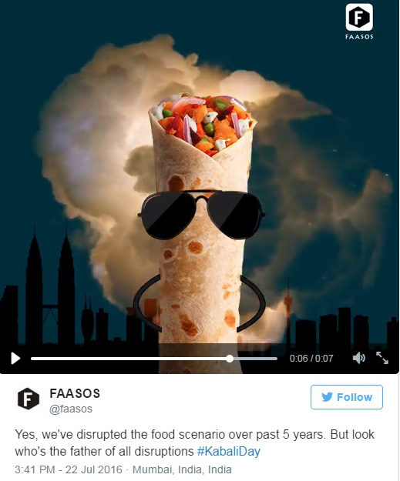
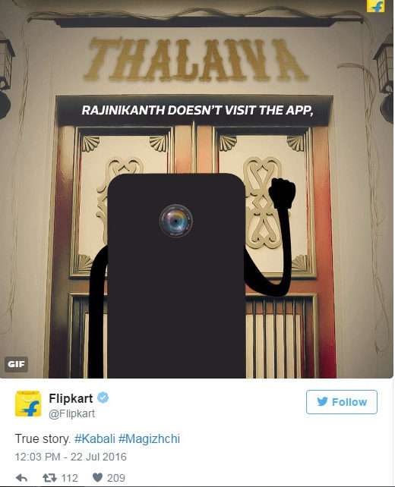
Social Media trends and buzz for the movie

Slide 23
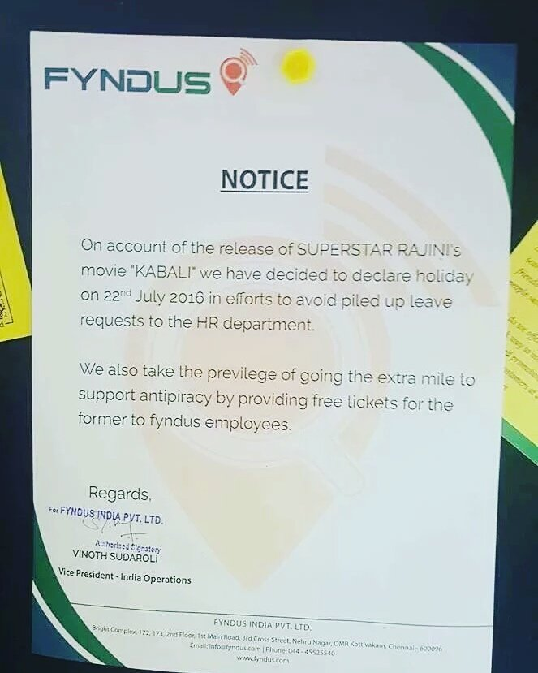
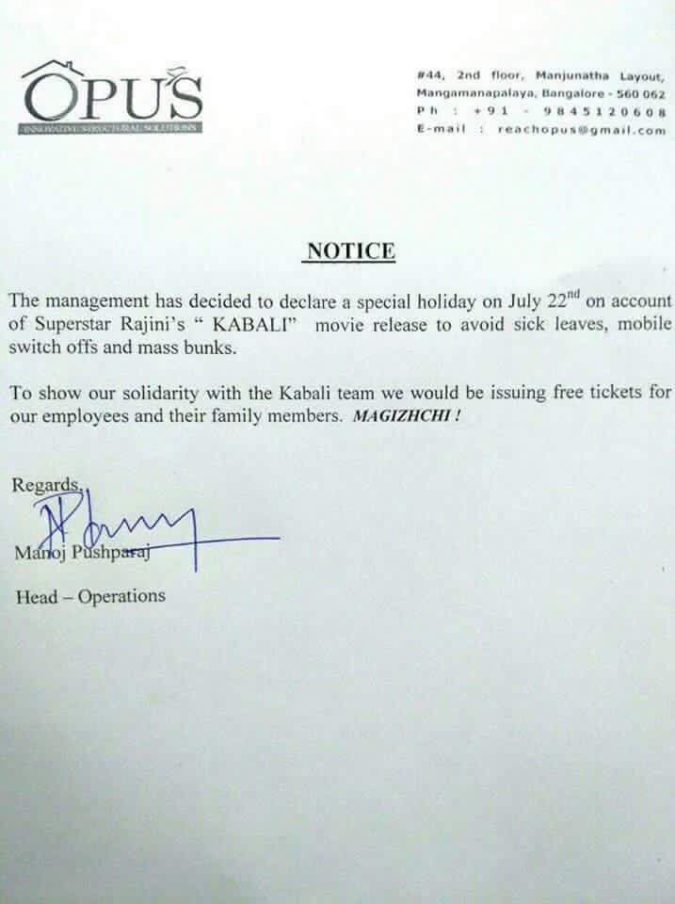
Kabali Day – Holiday declared in many companies of Chennai and Bangalore

Slide 24
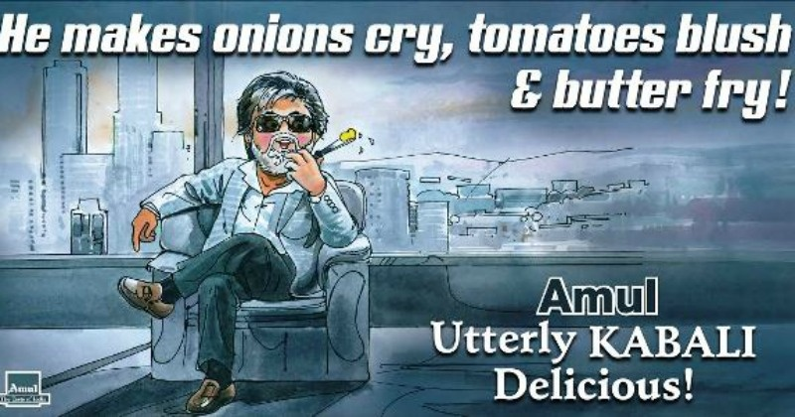
Amul – Publicity in newspapers and social networks

Slide 25
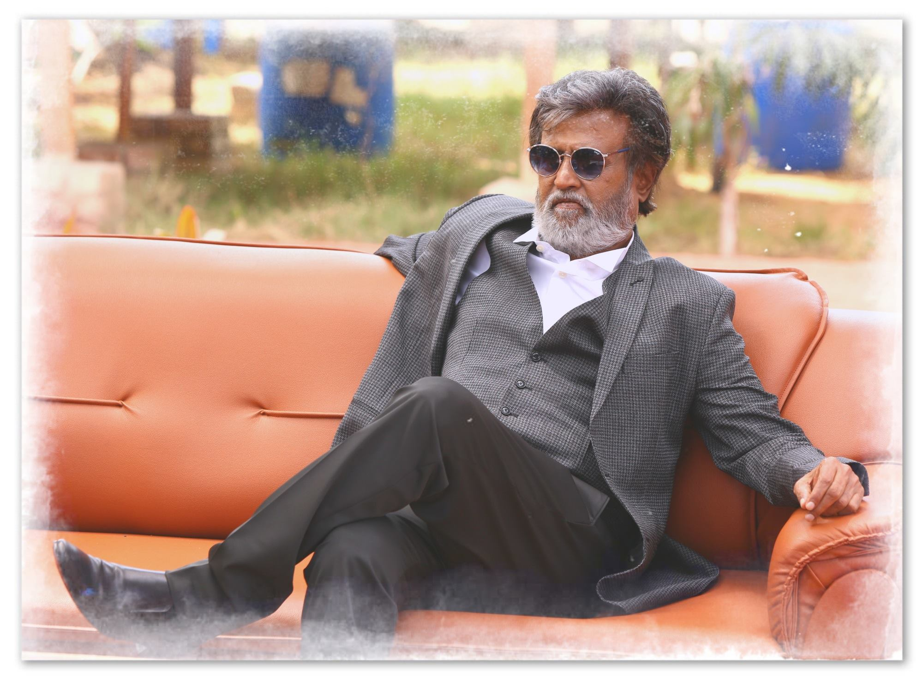
Thank You

